Slide 1

Iowa Vodka Sales Presentation
Presenter: Skillarchie Davis
Last Updated: 28/03/22

Slide 2
Presentation Flow
Project Overview
Project Objectives
Dashboard
Key Findings
Recommendation
Questions

Slide 3
Project overview
“With a good perspective on history, we can have a better understanding of the past and present, and thus a clear vision of the future.” Therefore, I choose the finance industry. My dataset was retrieved from Kaggle. The dataset contains information and data on historical Vodka sales in the state of IOWA over a four (4) years period. In the data preparation stage, I garnered an understanding of the dataset. Firstly, I cleaned the dataset. Secondly, I transformed the data to gather more meaningful insights for the data exploration stage. Thirdly, during the data exploration stage I created the dashboard. Finally, I then publish the dashboard for the presentation of my findings.

Slide 4
Project Objectives
Analyse market trends.
Sales optimization.

Slide 5
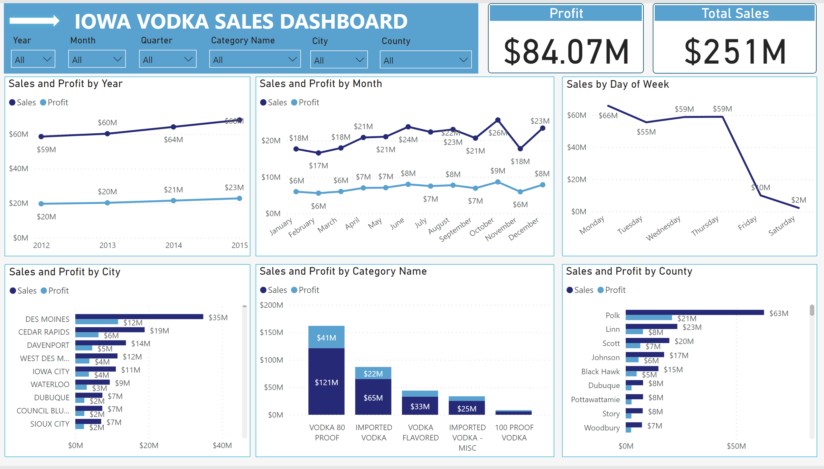

Questions

Slide 6
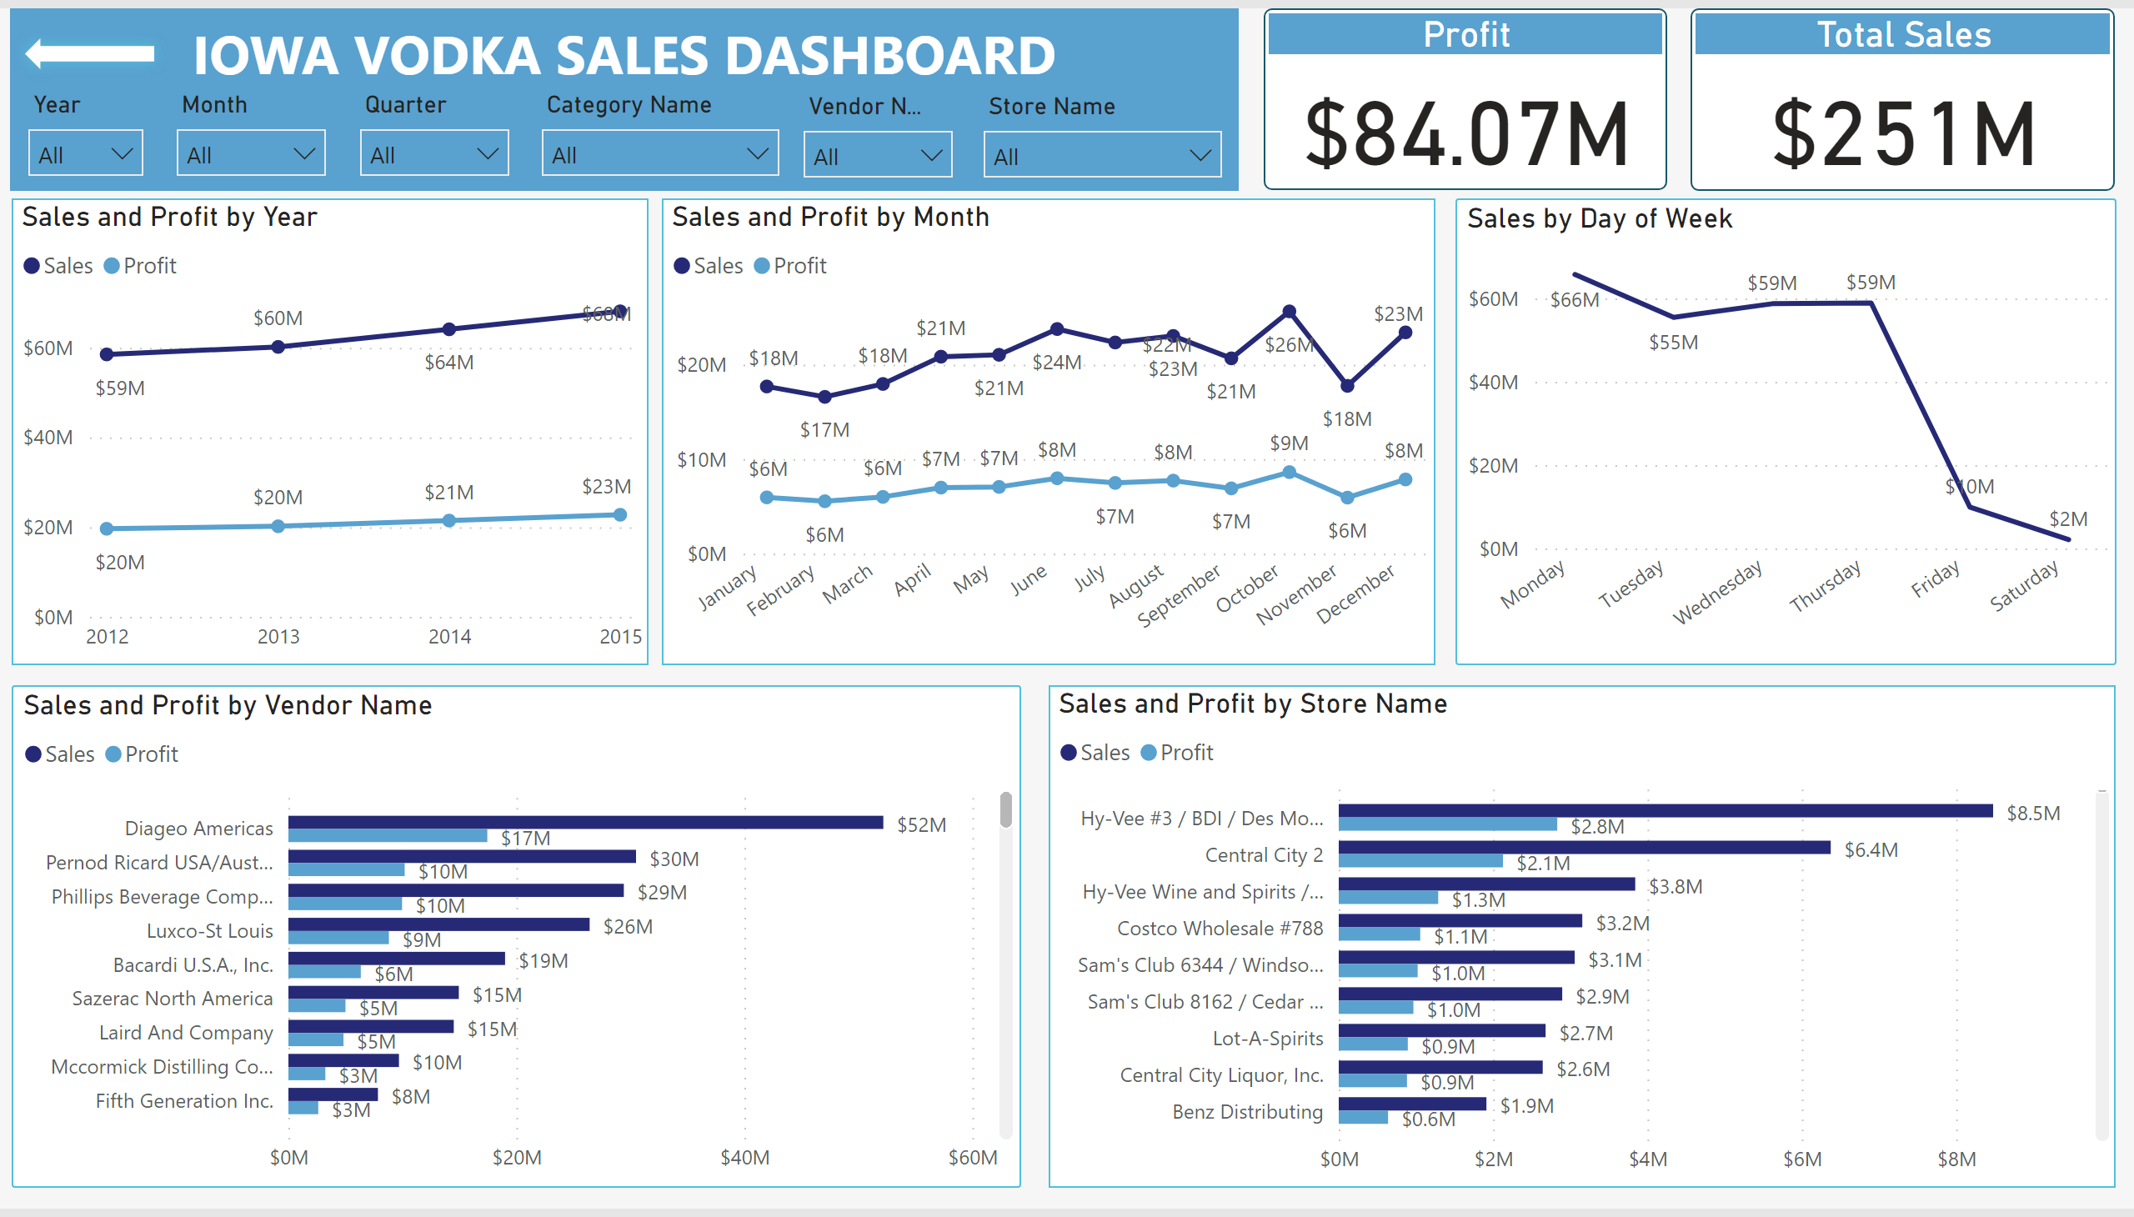

Slide 7

Key INSIGHTS

Slide 8
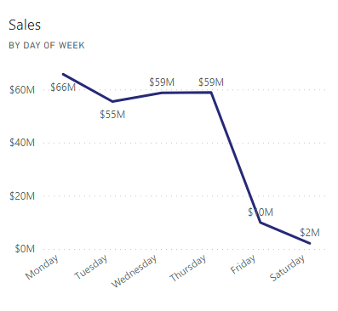
Sales and Profit by Weekdays
Alcohol is not sold on Sundays.
Sales peak in the early week with a sharp decline during the weekend.

Slide 9
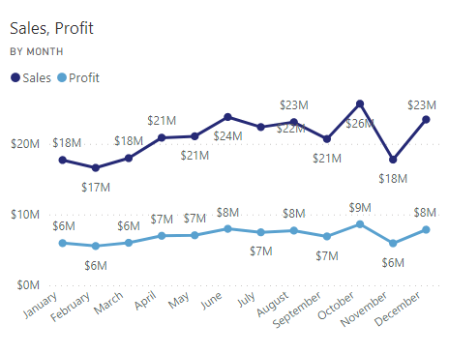
Sales and Profit by Month
The majority of the vodka sales happens during the summer.
The sharp decline in sales for November is related to buyers saving up for the Christmas holiday.

Slide 10
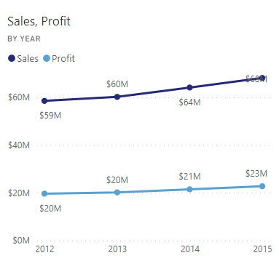
Sales and Profit by Year
A gradual increase in sales and profit annually.

Slide 11
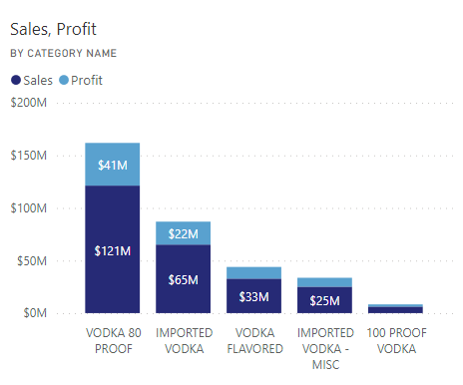
Sales and Profit by Category
Vodka 80 Proof is the best selling Vodka each year.
The total sales for Imported Vodka – cherry, Low Proof Vodka and Other Proof Vodka is below two hundred thousand (200k).

Slide 12
RECOMMENDATION
Release new Vodka brands or flavours to the market during the summer months.
Increase the importing and distribution amount for both Vodka 80 Proof and Imported Vodka categories.
Give bargain and discounts for most Vodka products on the weekends.
Give a 15 – 35% discount on the cost of Vodka during the month of November.

Slide 13

Questions

